Slide 1
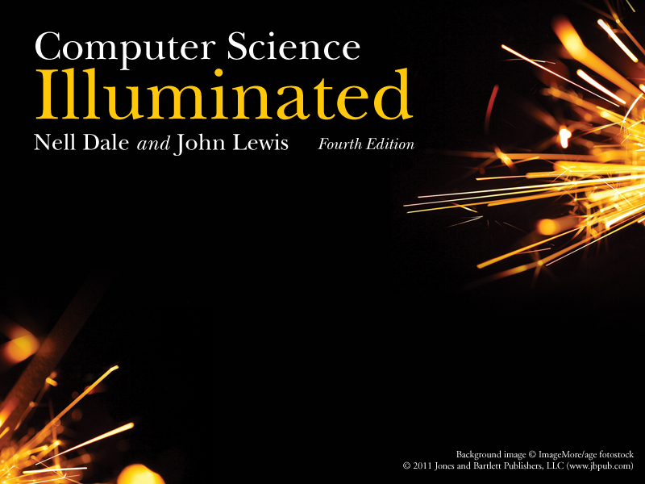
Chapter 1
The Big Picture

Slide 2
Chapter Goals
Describe the layers of a computer system
Describe the concept of abstraction and its relationship to computing
Describe the history of computer hardware and software
Describe the changing role of the computer user
Distinguish between systems programmers and applications programmers
Distinguish between computing as a tool and computing as a discipline
25

Slide 3
1.1 Computing Systems
Computing systems are dynamic!
What is the difference between hardware
and software?
2

Slide 4
1.1 Computing Systems (Cont.)
Hardware The physical elements of a computing system (printer, circuit boards, wires, keyboard…)
Software The programs that provide the instructions for a computer to execute
3

Slide 5
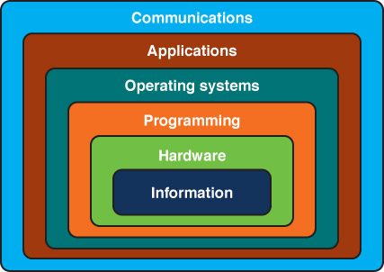
Layers of a Computing System
4

Slide 6
Abstraction
Abstraction(抽象化) A mental(精神上的) model that removes complex details
This is a key concept. Abstraction will reappear throughout the text – be sure you understand it!
5

Slide 7
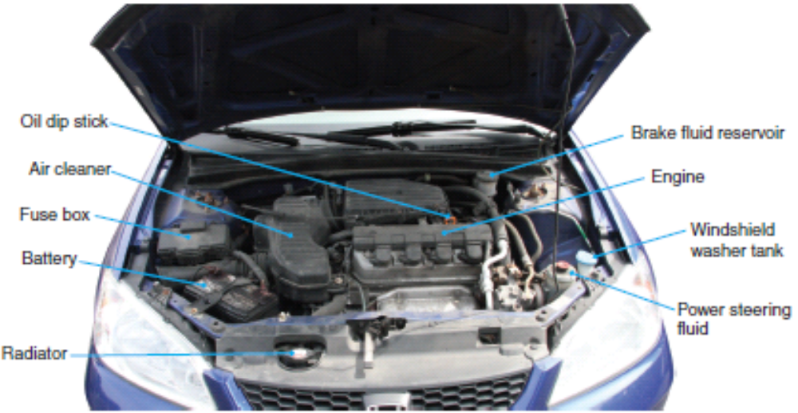
Internal View
(滴油器)
(煞車油儲槽)
(空氣清淨器)
(引擎)
(保險絲箱)
(電池)
(雨刷精儲槽)
(動力操控油儲槽)
(散熱器)

Slide 8
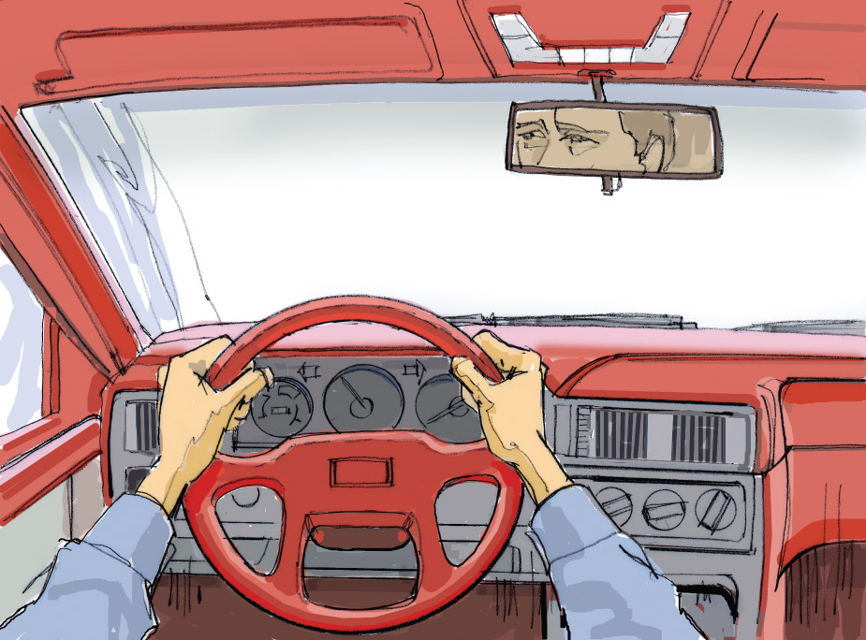
Abstract View

Slide 9
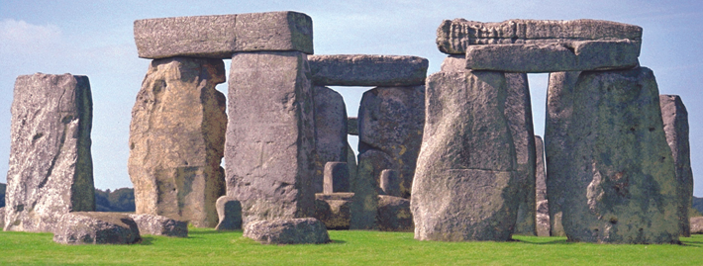
1.2 The History of Computing
Stonehenge(巨石陣):史前時代巨石陣是最早的曆法或占星術形式的計算機

Slide 10
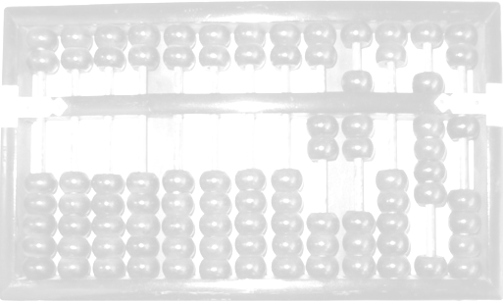
Early History of Computing
Abacus (算盤)
An early device to record numeric values
Blaise Pascal
Mechanical device to add, subtract, divide & multiply
Joseph Jacquard
Jacquard’s Loom, the punched card
Charles Babbage
Analytical Engine
6

Slide 11
Early History of Computing
Ada Lovelace
First Programmer, the loop
Alan Turing
Turing Machine, Artificial Intelligence Testing
*改變人類歷史的三顆蘋果
*模仿遊戲
Harvard Mark I, ENIAC, UNIVAC I
Early computers launch new era in mathematics, physics, engineering and economics
7

Slide 12
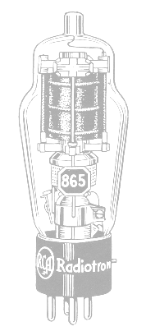
First Generation Hardware
(1951-1959)
Vacuum Tubes
Large, not very reliable, generated a lot of heat
Magnetic Drum
Memory device that rotated under a read/write head
Card Readers → Magnetic Tape Drives
Sequential auxiliary storage devices
8

Slide 13
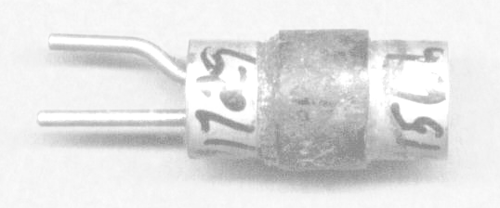
Second Generation Hardware
(1959-1965)
Transistor
Replaced vacuum tube, fast, small, durable, cheap
Magnetic Cores
Replaced magnetic drums, information available instantly
Magnetic Disks
Replaced magnetic tape, data can be accessed directly
9

Slide 14
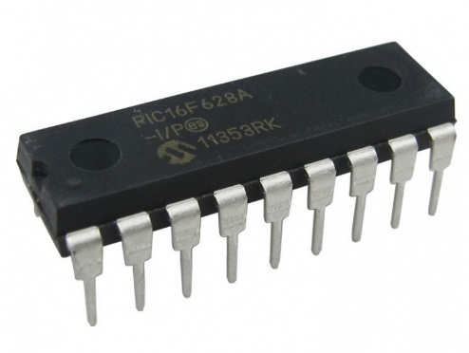
Third Generation Hardware
(1965-1971)
Integrated Circuits
Replaced circuit boards, smaller, cheaper, faster, more reliable
Transistors
Now used for memory construction
Terminal
An input/output device with a keyboard and screen
10

Slide 15
Fourth Generation Hardware (1971-?)
Large-scale Integration
Great advances in chip technology
PCs, the Commercial Market, Workstations
Personal Computers and Workstations emerge
New companies emerge: Apple, Sun, Dell …
Laptops
Everyone has his/her own portable computer
11

Slide 16
Parallel Computing and Networking
Parallel Computing
Computers rely on interconnected central processing and/or memory units that increase processing speed
Networking
Ethernet connects small computers to share resources
File servers connect PCs in the late 1980s
ARPANET and LANs → Internet
12

Slide 17
First Generation Software
(1951-1959)
Machine Language
Computer programs written in binary (1s and 0s)
Assembly Languages and Translators
Programs written using mnemonics (助譯指令), which were translated into machine language
Programmer Changes
Programmers divide into two groups: application programmers and systems programmers
13

Slide 18
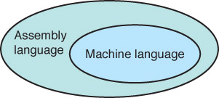
Assembly/Machine
Systems programmers
write the assembler
(translator)
Applications programmers
use assembly language to
solve problems

Slide 19
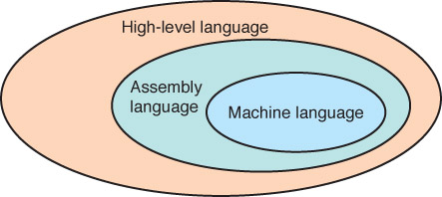
Second Generation Software
(1959-1965)
High-level Languages
English-like statements made programming easier:
Fortran, COBOL, Lisp
Systems
programmers
write translators for
high-level languages
Application
programmers
use high-level
languages to
solve problems
14

Slide 20
Third Generation Software
(1965-1971)
Systems Software
Utility programs (eg. 記事本, 小畫家, 磁碟重組, …)
Language translators (eg. Dev C, Dev C++, …)
Operating system, which decides which programs to run and when (eg. Windows 7, iOS, Android,…)
Separation between Users and Hardware
Computer programmers write programs to be used by general public (i.e., nonprogrammers)
15

Slide 21
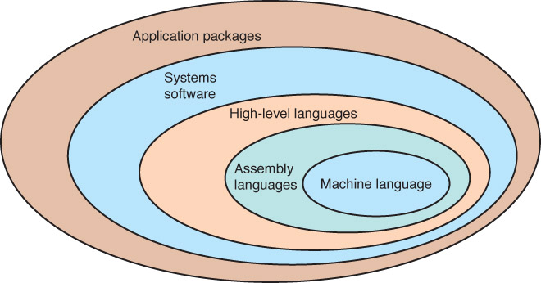
Third Generation Software
(1965-1971)
16

Slide 22
Fourth Generation Software
(1971-1989)
Structured Programming
Pascal
C++
New Application Software for Users
Spreadsheets
Word processors
Database management systems
17

Slide 23
Fifth Generation Software
(1990- present)
Microsoft
Windows operating system and other Microsoft application programs dominate the market
Object-Oriented Design
Based on a hierarchy of data objects (i.e. Java)
World Wide Web
Allows easy global communication through the Internet
New Users
Today’s user needs no computer knowledge
18

Slide 24
1.3 Computing as a Tool and a Discipline
Programmer / User
Systems Programmer
(builds tools)
Applications Programmer
(uses tools)
Domain-Specific Programs
User with No
Computer Background
20

Slide 25
Computing as a Discipline
What can be (efficiently) automated?
Four Necessary Skills
    Algorithmic Thinking
    Representation
    Programming
    Design
21

Slide 26
Computing as a Discipline
What do you think?
Is Computer Science a mathematical, scientific, or engineering discipline?
22

Slide 27
Examples of Systems Areas
Algorithms and Data Structures
Programming Languages
Architecture
Operating Systems
Software Engineering
Human-Computer Communication
23

Slide 28
Examples of Application Areas
Numerical and Symbolic Computation
Databases and Information Retrieval
Intelligent Systems
Graphics and Visual Computing
Net-Centric Computing
Computational Science
Data Science
24

Slide 29
Ethical Issues
The Digital Divide
  What is it?
  How does it affect you?
  What is computer literacy(能力) for
  your sister, the musician?
  your brother, the doctor?
  your sister, the kindergarten teacher?
  Is it important to try to bridge the digital divide?

Slide 30
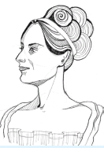
Who am I?
My name is Ada Byron
1. The first programmer
2. Design the first program
3. DoD of USA built A.I. programming language Ada in 1980
Can you list three items on my resume?

Slide 31

Do you know?
What computer company was launched in a
garage(車庫)?
What branch of mathematics is being used in
terrorist(恐怖分子) detection?
When and where were the first CS Departments
formed?
Apple
Graph theory
Purdue and Stanford in 1962

